Slide 1
Food Allergies
By: Kalyn Burnell, Dietetic Intern

Slide 2

Food Allergy vs Food Intolerance
Food Allergy- An abnormal response to a food, triggered by the body’s immune system.
  Example – milk allergy - an abnormal response of the body to the proteins found in cow's milk
  Allergy to cow’s milk is the most common food allergy in infants and young children

Slide 3
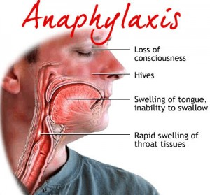
Allergy Symptoms
  Hives
  Wheezing
  Vomiting
  Diarrhea
  Abdominal cramps
  Anaphylaxis

Slide 4
Food Allergy vs Food Intolerance
Food intolerance- Sensitivity to a food. Generally less severe and often results in GI discomfort.
  Example: lactose intolerance – a deficiency of lactase, the enzyme that breaks down lactose.

Slide 5
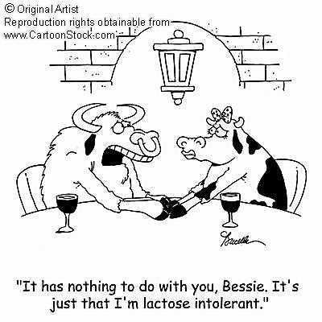
Lactose Intolerance
When lactose moves through the large intestine without being properly digested, it can cause uncomfortable symptoms such as gas, belly pain, bloating, and diarrhea.

Slide 6
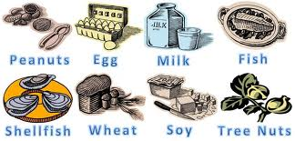
Top 8 allergens

Slide 7
Reading Ingredient Labels
In the United States, the FDA requires food manufacturers to list the eight most common ingredients that trigger food allergies.
Reading labels is the best way to stay safe. Any ingredients that aren’t clear should be looked up.

Slide 8
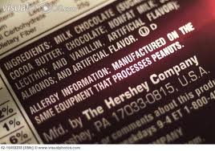
Reading Ingredient Labels

Slide 9
Cross-contamination
Cross-contamination occurs when a food that does not itself contain any allergens is tainted with an allergen during food preparation, cooking, storage, or serving. It can occur at home, in restaurants, or in manufacturing lines.

Slide 10
Hazard or no hazard?
A child eats toast with peanut butter in the morning before school. The family is running late and rushes out the door without washing the child’s hands or face.
HAZARD!

Slide 11
Hazard or no hazard?
Pineapple is on the menu today. There is a new child at your site who is allergic to pineapple. While dishing up the fruit you make 10 bowls and realize that you only need 9. You dump one serving back in and put pears in it instead for the child that has the pineapple allergy.
HAZARD!

Slide 12
Hazard or no hazard?
Pineapple is on the menu today. There is a new child at your site who is allergic to pineapple. While dishing up the fruit you make 10 bowls and realize that you only need 9. You dump one serving back in, place the bowl and utensil in the sink, wash your hands with hot soapy water, and put on new gloves. You then grab a new bowl and utensil and dish pears up instead for the child that has the pineapple allergy.
No hazard!

Slide 13
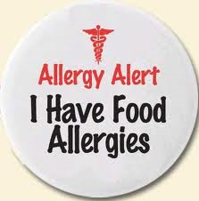
Food allergies at schools

Slide 14

Treatment
There is no cure for food allergies
Strict avoidance is the only way to stay safe
If an EPI pen has been prescribed it should be accessible at ALL times

Slide 15

Action Plan
Accidental ingestion does happen
Have an action plan in place at your site just in case!

Slide 16
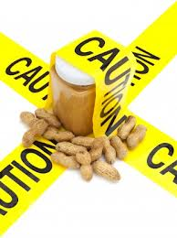
When Food Kills
http://www.youtube.com/watch?v=XC0nHFblLcE

Slide 17
References
www.foodallergy.org
www.aciaa.org
www.mayoclinic.com
www.kidshealth.org
www.community.kidswithfoodallergies.org
www.google.com (images)

